Slide 1
M. Tech (CSE) – Second Semester Non-CIE Component Quantum Computing(MCS22) Quantum error correction
Department of Computer Science and Engineering
Presented By: Shirisha AN
(1MS21SCS19)

Slide 2
Introduction to the repetition code
Basics of error correction
The basic ideas behind error correction are the same for quantum information as for classical information. This allows us to begin by considering a very straightforward example: speaking on the phone. If someone asks you a question to which the answer is 'yes' or 'no', the way you give your response will depend on two factors:
How important is it that you are understood correctly?
How good is your connection?

Slide 3
Both of these can be parameterized with probabilities. For the first, we can use P_{a}, the maximum acceptable probability of being misunderstood. If you are being asked to confirm a preference for ice cream flavors, and don't mind too much if you get vanilla rather than chocolate, P_{a} might be quite high. If you are being asked a question on which someone's life depends, however, P_{a} will be much lower.

Slide 4
For the second we can use p, the probability that your answer is garbled by a bad connection. For simplicity, let's imagine a case where a garbled 'yes' doesn't simply sound like nonsense, but sounds like a 'no'. And similarly a 'no' is transformed into 'yes'. Then p is the probability that you are completely misunderstood.

Slide 5
This same encoding scheme can also be used for binary, by simply substituting 0 and 1 for 'yes' and 'no'. It can therefore also be easily generalized to qubits by using the states |0⟩|and |1⟩ . In each case it is known as the repetition code.

Slide 6
Correcting errors in qubits
We will now implement these ideas explicitly using Qiskit . To see the effects of imperfect qubits, we simply can use the qubits of the prototype devices. We can also reproduce the effects in simulations.
The function below creates a simple noise model in order to do this. These go beyond the simple case discussed earlier, of a single noise event which happens with a probability p.

Slide 7
Instead we consider two forms of error that can occur. One is a gate error: an imperfection in any operation we perform. We model this here in a simple way, using so-called depolarizing noise.
The effect of this will be, with probability pgate ,to replace the state of any qubit with a completely random state. For two qubit gates, it is applied independently to each qubit.
The other form of noise is that for measurement. This simply flips between a 0 to a 1 and vice-versa immediately before measurement with probability pmeas.

Slide 8
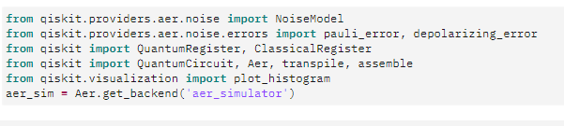
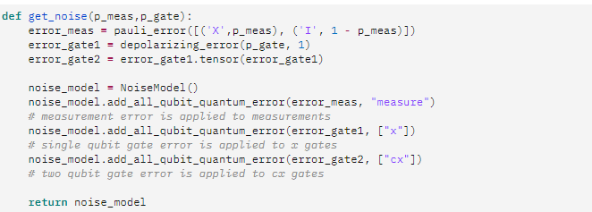

Slide 9
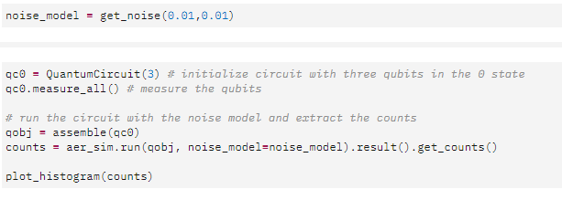

Slide 10
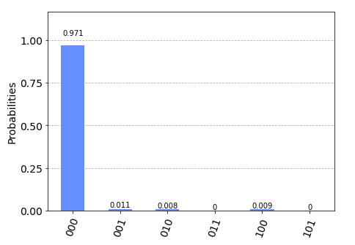

Slide 11
Storing qubits
So far, we have considered cases where there is no delay between encoding and decoding. For qubits, this means that there is no significant amount of time that passes between initializing the circuit, and making the final measurements.
However, there are many cases for which there will be a significant delay. As an obvious example, one may wish to encode a quantum state and store it for a long time, like a quantum hard drive. A less obvious but much more important example is performing fault-tolerant quantum computation itself. For this, we need to store quantum states and preserve their integrity during the computation. This must also be done in a way that allows us to manipulate the stored information in any way we need, and which corrects any errors we may introduce when performing the manipulations.

Slide 12
In all cases, we need account for the fact that errors do not only occur when something happens (like a gate or measurement), they also occur when the qubits are idle. Such noise is due to the fact that the qubits interact with each other and their environment. The longer we leave our qubits idle for, the greater the effects of this noise becomes.
The solution is to keep measuring throughout. No qubit is left idle for too long. Instead, information is constantly being extracted from the system to keep track of the errors that have occurred.

Slide 13
For the case of classical information, where we simply wish to store a 0 or 1, this can be done by just constantly measuring the value of each qubit. By keeping track of when the values change due to noise, we can easily deduce a history of when errors occurred.
For quantum information, however, it is not so easy. For example, consider the case that we wish to encode the logical state |+⟩. Our encoding is such that
|0⟩→|000⟩, |1⟩→|111⟩
To encode the logical |+⟩ state we therefore need
|+⟩=1√2(|0⟩+|1⟩)→1√2(|000⟩+|111⟩

Slide 14
Here we have three physical qubits. Two are called 'code qubits', and the other is called an 'auxiliary qubit'. One bit of output is extracted, called the syndrome bit. The auxiliary qubit is always initialized in state |0⟩|. The code qubits, however, can be initialized in different states. To see what affect different inputs have on the output, we can create a circuit qc_init that prepares the code qubits in some state, and then run the circuit qn_init+qc.

Slide 15
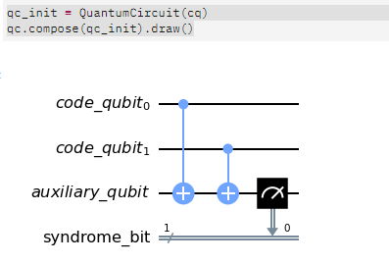
First, the trivial case: qc_init does nothing, and so the code qubits are initially |00⟩

Slide 16
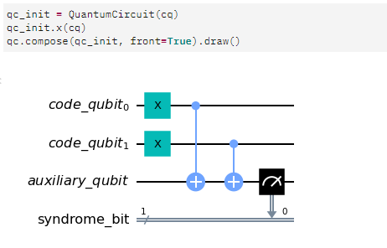
Now let's try an initial state of |11⟩.

Slide 17
Quantum repetition code
We now know enough to understand exactly how the quantum version of the repetition code is implemented.
The RepetitionCode contains two quantum circuits that implement the code: One for each of the two possible logical bit values. Here are those for logical 0 and 1 ,respectively.

Slide 18

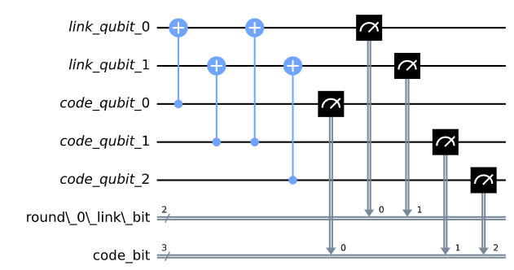

Slide 19
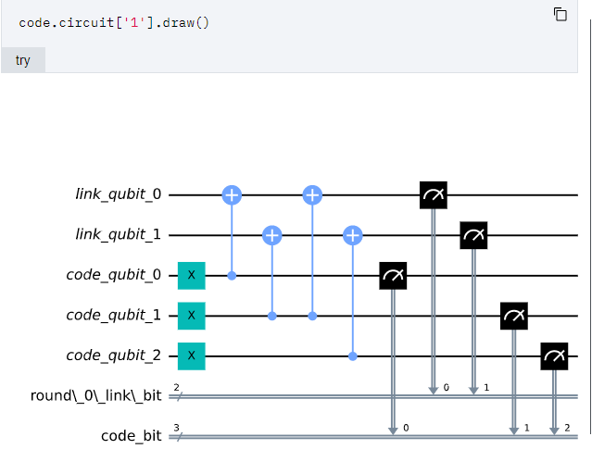

Slide 20
The Error Model
The first step in protecting information against errors is to understand the nature of the errors we are trying to protect against. Such an understanding is expressed by an error model.
It describes the evolution of set of bits. In analogy to the evolution or transformation that occurs on bits when they are being stored, or being moved around from one point of the computer to another, it is often called a channel.

Slide 21
The simplest classical error model is the bit-flip channel. In this model, the state of a bit is flipped with probability p, and is unaffected with probability 1 − p. The bit-flip channel is illustrated in Figure 10.1.
For the bit-flip channel, the probability p of a bit flip is independent of whether the bit is initially 0 or 1. A more complicated error model might have a different probability of error for bits in the state 0 than state 1.

Slide 22
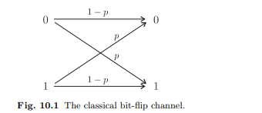
The bit-flip channel we consider is one where errors occur independently from bit to bit. More general error models would account for correlated errors between different bits. When errors described by a given model act on a register of bits in a circuit, we show this by a block labeled EC .

Slide 23
Encoding
Once we have a description of an error model, we want to encode information in a way that is robust against these errors.
This can be done by adding a number of extra bits to a logical bit that we wish to protect, and thereby transforming the resulting string into an encoded bit. The string of bits corresponding to an encoded bit is called a codeword.
The set of codewords (one for each of the two possible bit values 0 and 1) is called a code. The codewords are designed to add some redundancy to the logical bits they represent.

Slide 24
The basic idea behind the redundancy is that even when errors corrupt some of the bits in a codeword, the remaining bits contain enough information so that the logical bit can be recovered.

